Slide 1
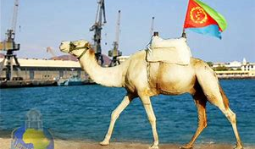
RED-SEA Camels
Group Members
Aaron-Gezai Id-109660
Efrem-Debesay Id-109428
Habtom-Gebre Id-109641
Samuel-Tesfabruk Id-109696
Professor- Joe Bruen
Date 09/25/2019

Slide 2
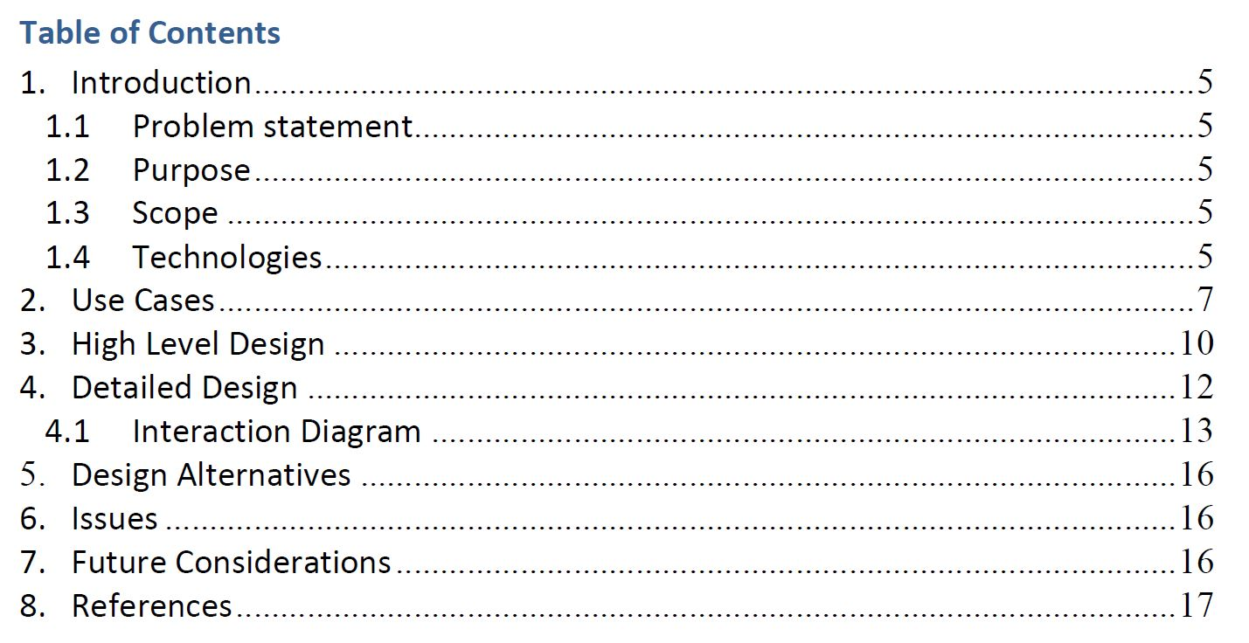

Slide 3

1. Introduction
1.1 Problem statement
Banking system is good example of enterprise application.
It deals with huge amount of daily transactions data, which should be maintained for business analysis.
It integrates many products and services together to achieve business goals, for example handling, adding new client, adding daily transaction, generate reports, route short messages …etc.

Slide 4

1.2 purpose
The purpose of our project is to demonstrates the capabilities of technologies and how to use them to address real-life enterprise issues.
It illustrates how to deal with huge amount of transactional data through archiving and make it available for adding transactions, reporting and data analysis purposes.
It also provides a highly available and scalable integration solution which guarantee data consistency across different applications. And provide high level of abstraction to integrate a loosely coupled services plus handling the interactions between these services with minimum effort using orchestration.

Slide 5
1.3 Scope
Our project introduces a service layer exposed through RESTful services to be invoked by external applications and integrated with Reporting systems through Spring Integration.
It has 2 batch jobs one for archiving daily transactions and generate aggregates and the other is responsible for generating monthly statements.

Slide 6
1.4 Technology
To achieve the mentioned functionality, we applied technologies such as
ORM
AOP
Spring Rest
Spring Batch
Spring Security
Spring Integration (AMQP – JMS)
Maven

Slide 7
2.0 USE Case
2.1 Add Client
Intent |  | Adding new client for Rainbow System
Description |  | Create new client with the following information: Client number, First Name, Last Name, Email, etc.
Preconditions |  | None
Success Post Condition |  | A new Client is created.
Failed Post Condition |  | Return a message to indicate failure causes.
MAIN FLOW
Step | Action
 | Enter the information for the new client (FirstName, Last Name, Client No and Email)
 | Then Submit
 | Rest web service will be called in order to create the client
 | If the client is created successfully, then a successful message will be shown
 | If the client is not created, then a failure message will be shown (there’s validation here try to leave the clientNo for example empty)

Slide 8
2.2) List All Clients
Intent |  | Listing all the clients in the system
Description |  | The user will list all the clients in the system
Preconditions |  | None
Success Post Condition |  | Clients retrieved successfully
Failed Post Condition |  | Return a message to indicate failure causes.
MAIN FLOW
Step | Action
 | The user pick to list all the clients
 | Rest web service will be called in order to list all the clients
 | If the clients were retrieved successfully, then they will be displayed
 | If there is a failure and error message will be displayed

Slide 9
2 .3 Add Transaction
Add Transaction
Intent |  | Group each client’s daily transaction on daily basis and create summary records for it. Then archive daily transaction details to another tables.
Primary Actor |  | Scheduled Daily Batch
Secondary Actors
Description |  | A scheduled Daily Batch Job reads the daily transaction for each client over the last day, and then groups those daily transaction as historical transaction, finally write the summary record to the data base, and archive the daily transaction details record.
Preconditions |  | A Client should have initiated at least one daily transaction for the specific day preceding the batch job scheduled time.
Trigger |  | Scheduled Daily Job
Success Post Condition |  | Daily Summary Records are created
Failed Post Condition
MAIN FLOW
Step | Action
1. | Define and Schedule Batch Job
2. | Batch Reader fetches clients over the specified day
3. | Get Call Records for the client over that day
4. | Create a summary for those daily transaction records
5. | A chunk of summary records are given to the batch writer
6. | Save the summary records by calling Service Layer.
RELATED INFORMATION
Performance
Frequency |  |  | Daily Schedule
NOTES & ISSUES
Future Considerations |  |  | Data Archiving

Slide 10
2.4 List Client Transaction by Client No
Intent |  | Listing all the transaction by clientNo
Description |  | Retrieving all the transaction based on a clientNo
Preconditions |  | Transaction should be there for a client
Success Post Condition |  | List of transactions are retrieved successfully
Failed Post Condition |  | Return a message to indicate failure causes.
MAIN FLOW
Step | Action
1 | The user will select to retrieve transactions by clientNo
2 | The user will enter the clientNo
3 | A Rainbow Rest web service will be called in order to retrieve all the transactions for this client
4 | If the transactions were retrieved successfully, then they will be displayed
 | If there is a failure and error message will be displayed

Slide 11
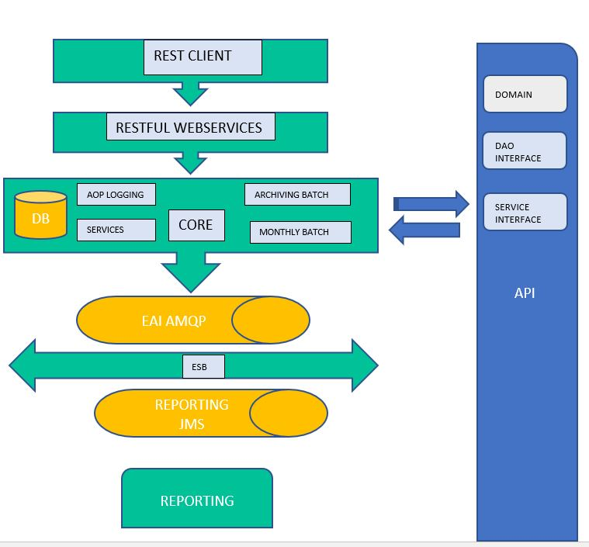
3. High-level Design

Slide 12
Main Components
API
Abstraction Layer holds the domain model, DOA Layer Interfaces, and Service Layer interfaces.
Rest-Client
Rest-Client is a console Based Application which calls restful web services in order to create client and create calls.

Slide 13
Restful Services
Restful services are exposed for client, and transaction creation.
Core
This layer is the implementation of Service and DAO interfaces. Provides logging on DAO and Service daily transaction using AOP.
Contains Daily Batch as well as Monthly Batch.
Daily Batch
Spring Batch that runs daily to archive daily transaction records from Daily transaction table and generate aggregate summary record with total daily transaction durations.

Slide 14
Monthly Batch
Scheduled to run monthly and generating monthly statement from each client daily transaction then dispatch the monthly statement to reporting systems.
ESB
ESB layer contains many adapters to communicate with various transports and includes routing and transformation logic for messaging from Rainbow-Core to Rainbow-Billing and Rainbow-Reporting systems and facilitate the integration of any future system.
Reporting
This System is responsible for Client transaction Summary Details Reporting after processing Clients Monthly statment Details message received on AMQP Queue from ESB.

Slide 15
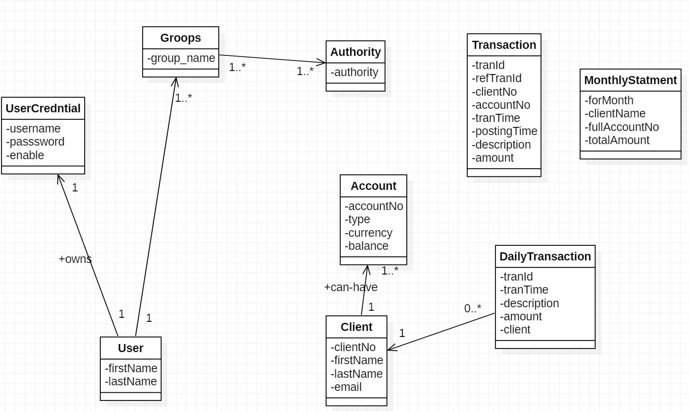
4. Detailed Design class-diagram

Slide 16
Figure-2 Domain Class Diagram
Authorities are assigned to groups. UserCredentials are assigned to grooups. Client has one credentials. There is ManyToMany relationship between Authorities and Groups, also between UserCredentials and Grooups. There is entity which represents a transaction. The DailyTransaction contains Client and Account. The monthly Statment for daily transaction is represented by MonthlyStatment.

Slide 17
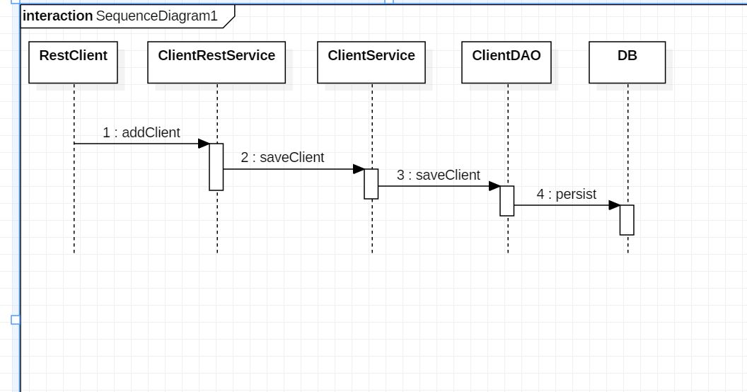
4.2 Sequence Diagram
We want to insert new record for new client.
There is Rest web service which accepts new client and passes it to clientService which passes it to clientDao for persistence into DB

Slide 18
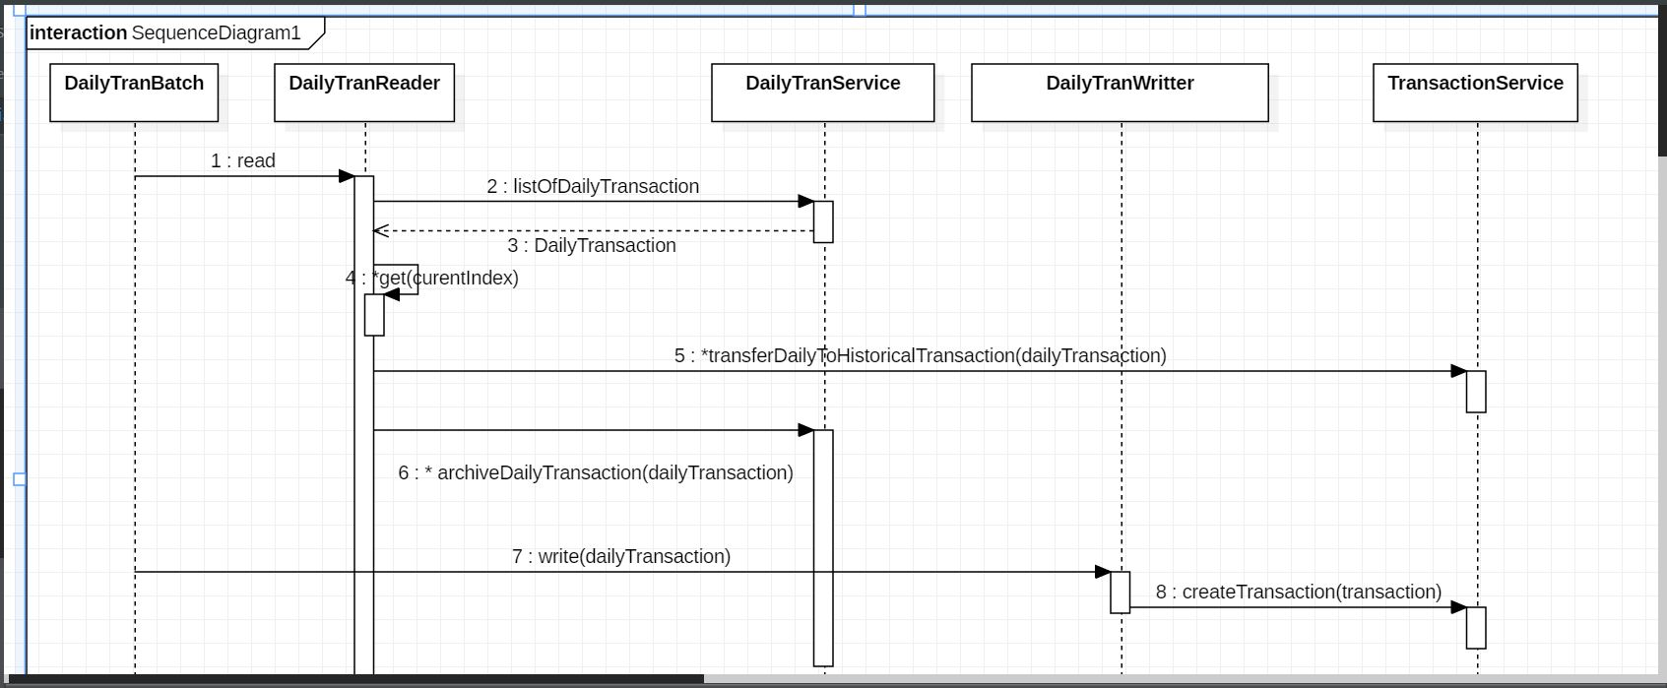
Daily Transaction Batch (Archiving) Sequence Diagram

Slide 19
Design Alternatives
We used Hibernate ORM, we can also use JDBC (Java Database Connectivity) to interact with the DB.
We made an Integration between Core and EAI through MQ (AMQP) in order to make it asynchronous and reliable. Instead, we can use web services through HTTP.
We used Restful webservices. As an alternative, we can expose our webservices through SOAP(complex design).
we used ESB (Enterprise Service Bus) as a middle ware framework to integrate between system components of a distributed system. Alternatively Integration between system components can be done through Point-to-point communication (Spaghetti style).
As an alternative, created calls can be processed in real time (online) but this will cause performance issues in the system. So, processing of created calls is done through batches daily and monthly.

Slide 20
Future Considerations
use Microservices architecture and split the application into a set of services that talk to each other via open APIs in order to achieve:-
better scalability
maintainability
loosely coupling services
better performance
Expose All web services on EAI or BUS Layer
That will imply more loosely coupling or direct dependency on a specific web services.
EAI will delegate web service calls behind the scenes.
Use OAuth on Authentication and Authorization of web services on the internet for

Slide 21


